Slide 1
Congress Trades and COVID-19
Group TS²
Notes:
Sounds like the Episode Name of a Sitcom– *chef’s kiss*

Slide 2
HYPOTHESIS
We expect that it will be beneficial to make investments based on the performance of high earning politicians, and to find the top companies the politicians invested in so that outsiders can mimic their investments based on a given politician
Notes:
Woohoo! Hypothesize this!

Slide 3
Executive Summary
The focus of the analysis was to find out if it is beneficial to make investments based on the volume of trades, or on the performance of high earning politicians, and to identify what stocks are being traded, as well as to make future predictions based on the performance of a political party and politicians.

Slide 4
Group Approach
The group identified the main questions we wanted to have answered based on the data we had. Each person in the group came up with questions, and questions were divided among the members for each person to then analyze on their.

Slide 5
EXCESS RETURNS
What is an Excess Return?
Excess returns are returns achieved above and beyond the return of a proxy
A positive excess return shows that an investment outperformed its comparison
A negative excess return shows that an investment underperforms.
Notes:
A simple definition that helps/compliments most of our analysis.

Slide 6
Top 6 Traders
(Excess Return Averages–2019-2021)
Section By Shayne
Notes:
Ooo! My Time to shine, yay me!!!

Slide 7
Top 6 Traders (2012-2024)--(2019-2021)
Top 3 Democrats
Josh Gottheimer - 2786 total trades — 1179 total trades
Lois Frankel - 1358 total trades — 436 total trades
Susie Lee - 1262 total trades — 1180 total trades
Top 3 Republicans
Thomas Macarthur - 2758 total trades — 1 total trade
David Perdue - 2242 total trades — 828 total trades
Greg Gianforte - 1331 total trades — 771 total trades

Slide 8
Top Traded Company
What is the average excess returns for these companies?
(2019-2021)

Slide 9
What Were the Most Common Company Stocks Purchased From (2019-2021)?
Top 3 Democrats
Josh Gottheimer - Microsoft Corporation - 156 total trades
Lois Frankel - Dupont De Nemours, Inc. - 10 total trades
Susie Lee - Ball Corporation - 21 total trades
Top 3 Republicans
Thomas Macarthur - Interactive Brokers Group Inc. - 1 total trade
David Perdue - Caesars Entertainment Corporation - 33 total trades
Greg Gianforte - AMN Healthcare Services Inc. - 15 total trades

Slide 10
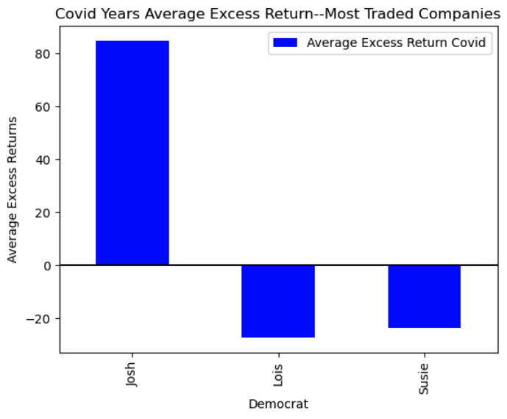
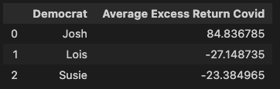
Relevant Plots
Most Common Companies
Democrats–
Josh Gottheimer - Microsoft Corporation
Lois Frankel - Dupont De Nemours, Inc.
Susie Lee - Ball Corporation

Slide 11
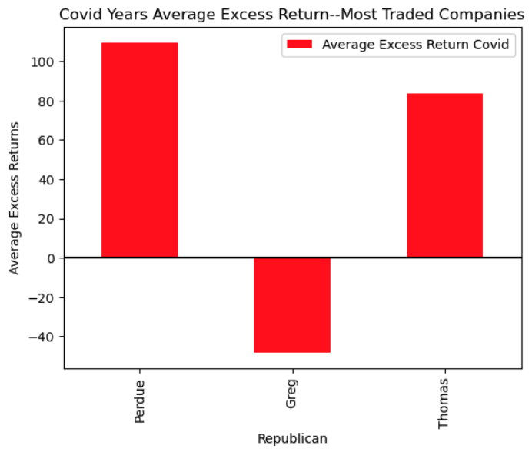
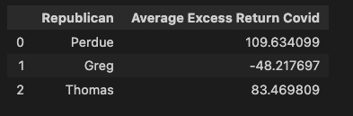
Relevant Plots
Most Common Companies
Republicans–
Thomas Macarthur - Interactive Brokers Group Inc.
David Perdue - Caesars Entertainment Corporation
Greg Gianforte - AMN Healthcare Services Inc.

Slide 12
All Companies
What was the excess return average for the traders?
(2019-2021)

Slide 13
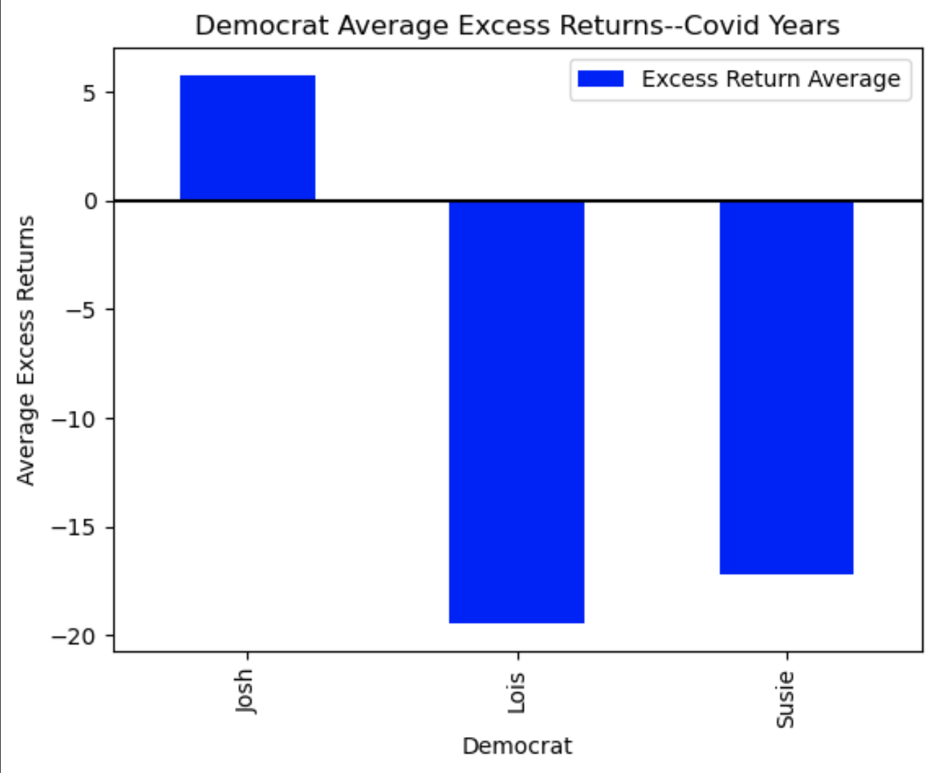
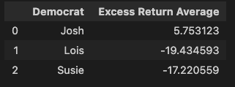
Relevant Plots
All Companies
Democrats–

Slide 14
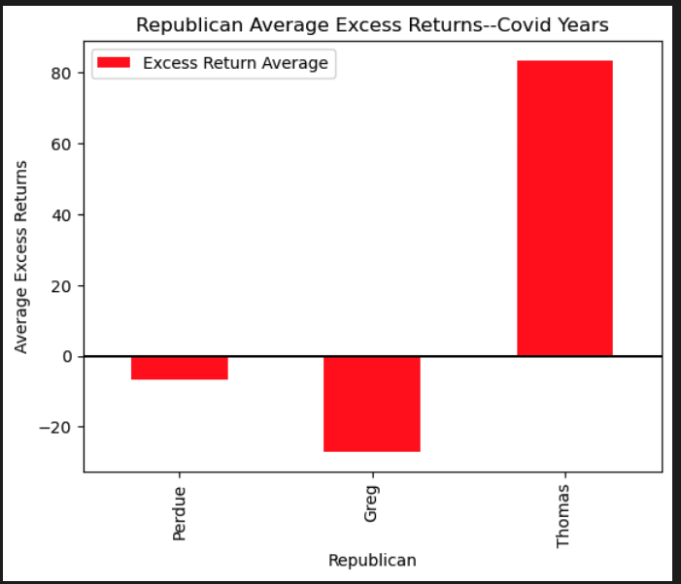
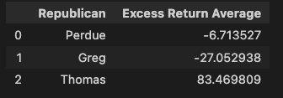
Relevant Plots
All Companies
Republicans–

Slide 15
Top 6 Highest Earners

Slide 16
Excess Return by Party for All Years
Overall for all trades, both parties were extremely negative in their losses for the sum of their excess returns.
Republicans -548,337.29
Democrats -123,073.97
Based on the analysis of the excess return by party, it is not worth making investments based on a political party.
Notes:
A simple definition that helps/compliments most of our analysis.

Slide 17
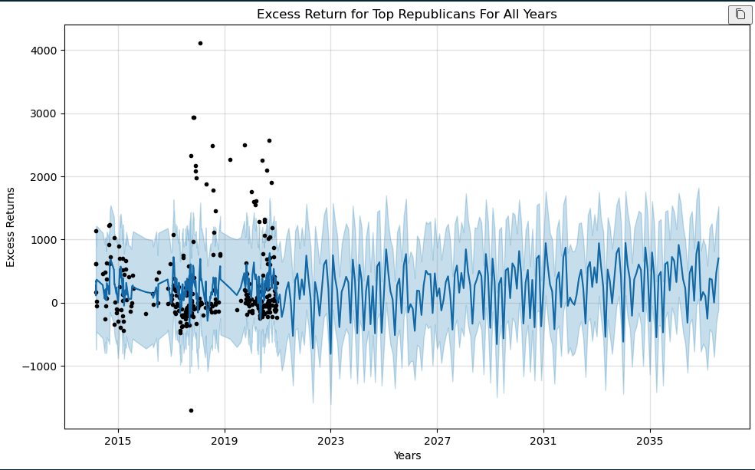
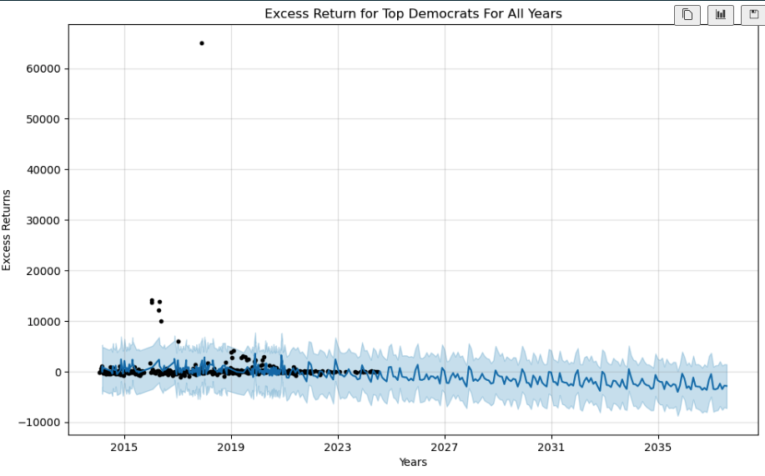
Excess Return by Party for Top Performers
Democrats had a higher excess return than the Republicans
Democrats came out to 151,888.77
Republicans came out to 77,908
48.71% higher excess return based on the performance of the Democrats
Notes:
A simple definition that helps/compliments most of our analysis.

Slide 18
Excess Return by Party for Top Performers 2019-2021
Excess return by party from 2019-2021 was a lot closer
Republicans 35,392.47
Democrats 30,051.73
Republicans were 17.80% higher than the democrats
Notes:
A simple definition that helps/compliments most of our analysis.

Slide 19
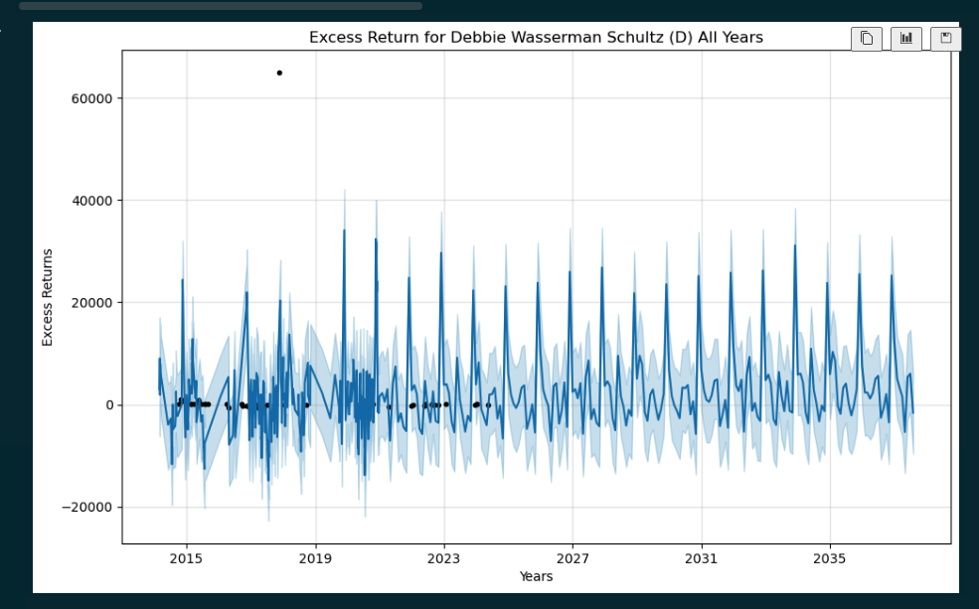
Which politician performed the best across all years?
Debbie Wasserman Schultz (D) had the highest excess return of 64,404.63 for all years.
The highest performing Democrat out-earned the highest earning Republican by 39.16%.
Notes:
A simple definition that helps/compliments most of our analysis.

Slide 20
Is it worth making investments based on a single top performing politician?
Yes, it is worth making investments based on the performance of a single politician based on how well they are currently performing.
It is not worth making investments based on a politician based on overall volume of trades.

Slide 21
Healthcare stock trends 2019-2021

Slide 22
What were the most traded health stocks during this time period for each party?
& what companies were they?
These were the top traded stocks for the republicans: AMN Healthcare Services
These were the top traded stocks for the democrats: HCA Healthcare

Slide 23

What was the average excess return?
The democrats had a higher average excess return, 83%, with healthcare stocks from 2019-2021 as opposed the the republicans with a sad -53%.

Slide 24
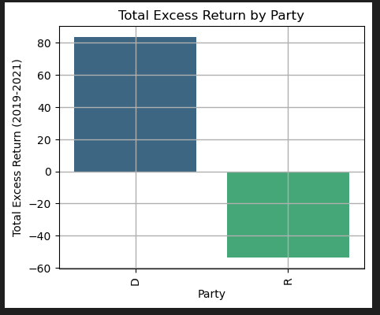
Graphed excess return average over the the 3 year period

Slide 25
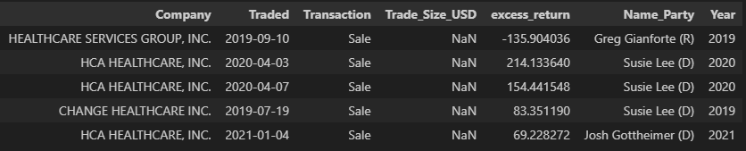
Is worth making investments into healthcare stock based on political party?
From the findings, it would be worth it to follow a party, the democrats in this instance, based on their average excess return.
The republican data was very slim, will look into further. However, it would seem to be more beneficial to follow an individual, rather than a party.
Susie Lee (D) had the more profitable trade of HCA Healthcare on April 3,2020 at a 214% gain.
Greg Gianforte (R) had the least profitable trade of Healthcare Services Group on September 10, 2019 at a -135% loss.
The data I was working with didn’t display the $USD amount for this specific time period with the sector selected. Was unable to find any dollar amounts range Will look into other data sources to explore this further.

Slide 26
Future research
We did not do any research into investments of pharmaceutical companies and healthcare suppliers. Adding these points of data would help pinpoint better investments and what investments would’ve been bigger winners as well as help predict future possibilities.
We also did not compare the difference between stock performance from 2019-2021 to years before or after. This also would have helped us identify if specific traders or companies were able to make a lot of money during the pandemic.

